Slide 1
Introduction and Unit 1
Quantum Mechanics
I B Tech GR 20 Applied Physics
Dr. G. Patrick

Slide 2
Unit 1
Quantum Mechanics
Introduction, Black body radiation, Planck’s law, Photoelectric effect- Einstein's Photoelectric equation, Compton effect (Qualitative), Wave-Particle duality, de Broglie hypothesis, Davisson and Germer experiment, Heisenberg’s uncertainty principle, Born’s interpretation of the wave function, Schrodinger’s time independent wave equation, Particle in one dimensional infinite potential box.

Slide 3
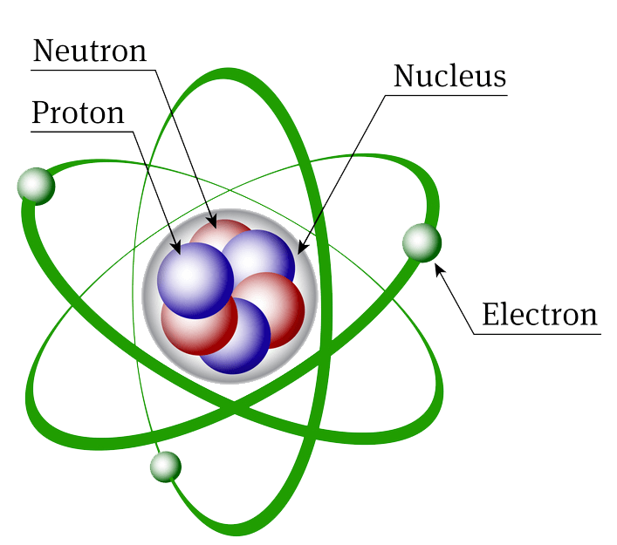
Atomic Structure

Slide 4
Atoms and ions
Atoms are electrically neutral.
Atoms lose or gain electrons to attain stability.
When an atom looses an electron, it becomes a positive ion or cation.
When an atom gains an electron, it becomes a negative ion or anion.
A crystal or crystalline solid is a solid material whose constituents (such as atoms, molecules, or ions) are arranged in a highly ordered microscopic structure, forming a crystal lattice that extends in all directions.

Slide 5
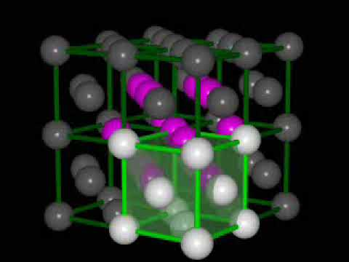
Crystalline solid

Slide 6
Bonding in solids
Types of bonding
Ionic bonding
Covalent bonding
Metallic bonding
Hydrogen bonding
Van der Waals bonding

Slide 7
Orbits and Orbitals
The innermost shell or orbit has the lowest energy level. The furthest orbit has the highest electron energy level.
Each orbit has a certain capacity and can hold only a certain number of electrons.
The inner shells must be filled first before going to the next level.
An atom in its lowest possible energy state (called the ground state).

Slide 8
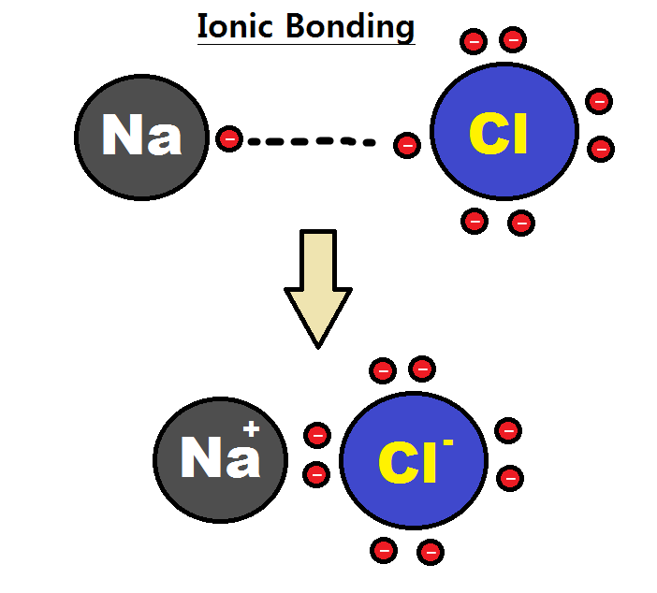
Ionic bonding
An ionic bonding is the attractive force existing between a positive ion and a negative ion when they are brought close.
Properties
Crystalline in nature
Hard and brittle
High melting and boiling points
Good insulators of electricity.

Slide 9
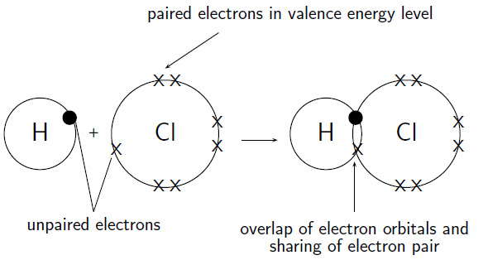
Covalent bonding
In covalent bonding the stable arrangement of electrons in an outer shell is achieved by a process of valence electron sharing rather than electron transfer.
Properties
Directional
Low melting and boiling points compared to ionic bonds
Pure covalent solids are good insulators of electricity at low temperature.
Semiconductors like germanium and silicon are covalent solids.

Slide 10
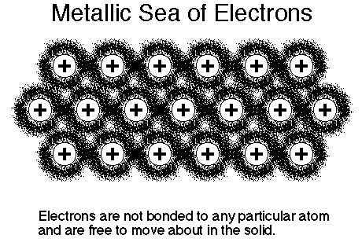
Metallic bonding
The valence electrons from all the atoms belonging to the crystal are free to move throughout the crystal.
The crystal may be considered as an array of positive metals ions present in a cloud or sea of free electrons.

Slide 11
Metallic bonding
Metallic bonds are relatively weak
Metallic solids are malleable and ductile
Metallic bond is non directional
Possess high electrical and thermal conductivity
Metals are opaque to light.

Slide 12
Classical and Quantum Mechanics
Classical Mechanics | Quantum Mechanics
It deals with macroscopic particles | It deals with microscopic particles
It is based on Newton’s Law of motion | It takes into account Heisenberg’s uncertainty principle and de Broglie concept of dual nature of matter
It is based on Maxwell’s electromagnetic wave theory according to which any amount of energy may be emitted or absorbed continuously | It is based on Planck’s quantum theory according to which only discreet values of energy are emitted or absorbed
The state of a system is defined by specifying all the forces acting on the particles as well as their positions and velocities (momentum). The future state can then be predicted with certainty. | It gives probabilities of finding the particles at various locations in space.

Slide 13
Black Body Radiation
A body that completely absorbs radiation of all wavelengths incident on it is referred to as a blackbody. When such a body is heated, it emits radiation called as blackbody radiation.
Radiation emitted by a body due to temperature is called thermal radiation.
Thermal radiation is electromagnetic in nature and its energy is smoothly distributed over all wavelengths.
A thermal source produces continuous spectrum.

Slide 14
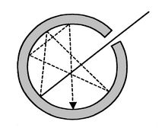
Black Body Radiation
A cavity made out of a hollow container of any material (iron or copper) with a narrow opening and painted with lampblack in the inside portion resembles a blackbody.

Slide 15
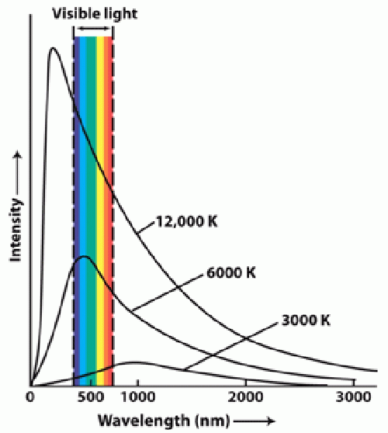
Spectrum of Black Body Radiation
At a given temperature, the intensity of radiation initially increases with increasing wavelength, reaches a peak and then decreases.
The spectral distribution of radiation is a function of temperature alone.
The position of maximum peak shifts towards lower wavelength with increasing equilibrium temperature.

Slide 16
Black Body Radiation
Classical mechanics could not explain the spectrum of black body radiation.
Max Planck proposed the Planck’s radiation law which could explain the spectrum of black body radiation.

Slide 17
Planck’s Law
Max Planck in 1900 introduced the quantum theory of radiation to explain the distribution of energy in the spectrum of black body radiation i.e. frequency distribution of thermal radiation.
He assumed that the atoms of the walls of the blackbody behave like small harmonic oscillators, each having a characteristic frequency of vibration.

Slide 18
Planck’s Law
Planck’s assumptions:
An oscillating atom can absorb or reemit energy in discrete units. The indivisible discrete unit of energy is “hν” and is called energy quantum (E). E = hν
Where h is the Planck’s constant and ν is the frequency of radiation.
The energy of the oscillator is quantized. It can have only certain discrete values of energy E_{n .} E_{n} = n hν where n = 1, 2, 3, …

Slide 19
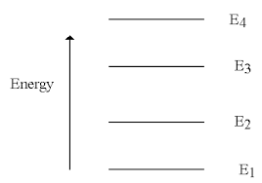
Planck’s Law
The hypothesis that radiant energy is absorbed or emitted in a discontinuous manner and in the form of quanta is known as Planck’s quantum hypothesis.

Slide 20
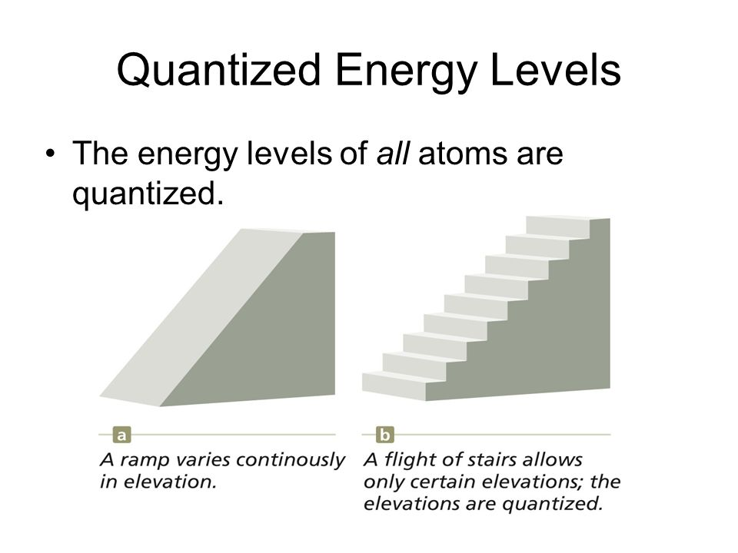
Continuous and quantized

Slide 21
Properties of Photons
Energy of photon: E = hν
Velocity: Photons travel with velocity of light.
Rest mass: Photon can never be at rest.
Relativistic mass: E = m c² or m = E/ c²
Linear momentum P = h/λ
Electric charge: Photons are electrically neutral and cannot be influenced by electric and magnetic field.
They cannot ionize matter.

Slide 22
Photoelectric effect
Photoelectric effect establishes that light behaves as streams of particles.
Hertz gave experimental evidence of photoelectric effect.
Einstein explained Photoelectric effect using Planck's quantum theory.

Slide 23
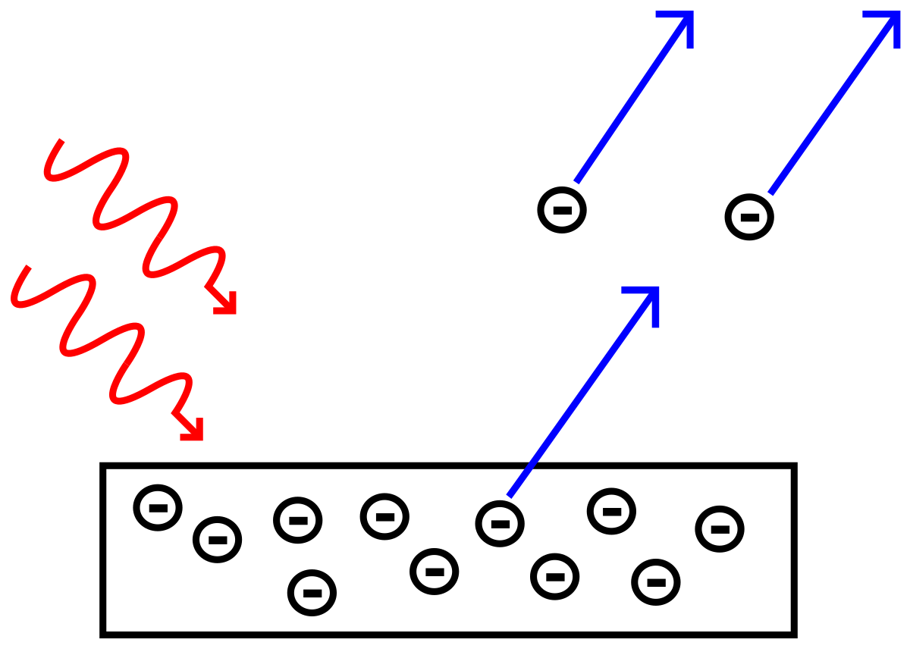
Photoelectric effect
The emission of electrons from a metal plate when illuminated by light radiation of suitable wavelength or frequency is called photoelectric effect. The emitted electrons are called photo electrons.
(Bound electrons are emitted in Photoelectric Effect)

Slide 24
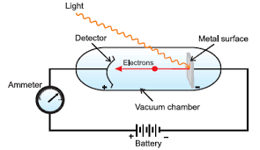
Photoelectric effect – Experimental arrangement
The set up consists of a vacuum chamber consisting of a metal surface and a detector metal plate.
The metal surface is connected to negative terminal of the battery and the detector metal plate is connected to positive terminal of the battery.

Slide 25
Photoelectric effect – Experimental arrangement
In the absence of light, there is no flow of current and hence there is no deflection in the ammeter. When monochromatic light falls on the metal surface, a current starts flowing in the circuit shown by the ammeter. The current is known as photo current.

Slide 26
Characteristics of Photoelectric effect
Threshold frequency is different for different materials.
Photoelectric current is directly proportional to the intensity of light.
The kinetic energy and stopping potential of photoelectrons is directly proportional to the frequency of light.
It is an instantaneous process.

Slide 27
Einstein’s Photoelectric equation
Einstein explained Photoelectric effect using Planck's quantum theory i.e. energy is given out in packets called as quanta.
Energy Supplied = Energy Consumed in ejecting an electron + maximum Kinetic energy of electron (or)
Energy Supplied = Work function+ maximum Kinetic energy of electron
hν = hν₀ + K.E.

Slide 28
Applications of Photoelectric effect
Used to generate electricity in Solar Panels.
Lighting sensors such as the ones used in smart phones enable automatic adjustment of screen brightness according to the lighting. This is because the amount of current generated via the photoelectric effect is dependent on the intensity of light hitting the sensor.
Digital cameras can detect and record light because they have photoelectric sensors that respond to different colors of light.

Slide 29
Compton Effect
Compton effect is the name given to the scattering of x-ray radiations by electrons that are weakly bound to the atoms in the target.
The American Physicist Arthur H. Compton discovered this effect.
The Compton effect can be explained on the basis of quantum theory of light.
Compton effect provides the direct confirmation of the particle nature of electromagnetic radiation.

Slide 30
Compton Effect
Compton discovered that when a monochromatic radiation of high frequency like X-rays is scattered by a substance, the scattered radiation contains two components, one having a lower frequency or higher wave length and the other having same frequency or wave length. The radiation of unchanged frequency in the scattered beam is known as unmodified radiation while the radiation of lower frequency(or higher wavelength) is called as modified radiation. This phenomenon is known as Compton Effect.

Slide 31
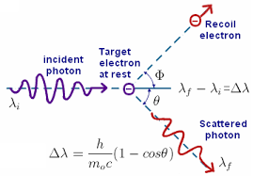
Compton Effect
A beam of monochromatic wavelength ( ) is incident on a target.
The wavelength of the scattered x-rays are measured at various scattering angles(ϴ).
The scattered radiation consists of a displaced component( )
Compton shift

Slide 32

Compton Effect
The Compton scattering results in
1) modified frequencies or wave length ( )
2) unmodified frequencies or wave length ( ) Compton found that the shift in wavelength depends on the scattering angle ϴ and is independent of the initial wavelength or the scattering substance.
or (1 - cos ϴ)

Slide 33
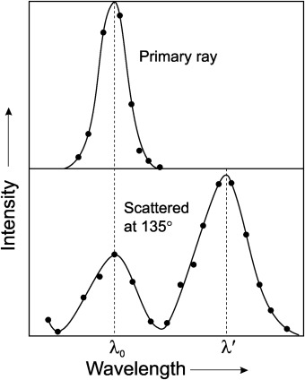
Compton shift = and =

Slide 34
Compton Effect
Modified wavelength occurs due to collision of x-ray photons with free electrons. On collusion the x-ray photon looses energy and hence frequency decreases or wavelength increases.
Un modified wavelength is due to collision of x-ray photons with the tightly bound electrons in the target. The whole atom is involved in the collusion and hence is the mass of the atom which is large. Hence shift is negligible.

Slide 35
Wave particle duality: de-Broglie hypothesis
In 1924 Louis de-Broglie extended the wave particle dualism to all matter particles.
If light can act as a wave sometimes and as particles at other times, then matter particles like electron can also behave as waves.
According to this hypothesis, all matter particles in motion possess a wave character also. The waves associated with matter particles is called as matter waves or de-Broglie waves.

Slide 36



de-Broglie wavelength of matter waves
Energy of a photon
Where c = velocity of light, λ = wavelength of photon and h = Planck's constant
According to Einstein’s mass energy relation
where m = mass of photon
From the above equations
Or where p is the momentum of the photon.

Slide 37

de-Broglie wavelength of matter waves
de-Broglie proposed that like photons all matter particles have dualistic behaviour.
For a matter particle of mass m moving with a velocity v, wavelength

Slide 38


de-Broglie Wavelength in terms of K.E
Wavelength in terms of kinetic energy
Let E = K.E. of the particle =
Multiply and divide by m
E = p² / 2m or p =
λ = h/p
λ =

Slide 39




de-Broglie wavelength for electrons
If a velocity v is given to an electron by accelerating it through a potential difference V , then the work done on the electron is ‘eV’, and the work done is converted into the kinetic energy of an electron.
Multiply both sides with m
where h= 6.625 x 10⁻³⁴ J sec,
m = 9.1 x 10⁻³¹ kg and
e = 1.6 x 10⁻¹⁹ C

Slide 40
Properties of Matter waves
Lighter the particle, greater will be the wavelength associated with it.
Smaller the velocity of the particle, greater will be the wavelength associated with it.
Matter waves are generated by the motion of the particles.
Waves are produced whether the particles are charged or uncharged.
Matter waves are not electromagnetic waves.
The wavelength of matter waves is not a constant. It depends on the velocity of matter particles.

Slide 41
Davisson and Germer Experiment
Waves exhibit diffraction and hence if de Broglie hypothesis is valid, then the matter waves should exhibit diffraction effects.
In 1927, Davisson and Germer observed the diffraction of an electron beam incident on a nickel crystal.
The experiment provided a convincing proof of the wave nature of matter particles.

Slide 42
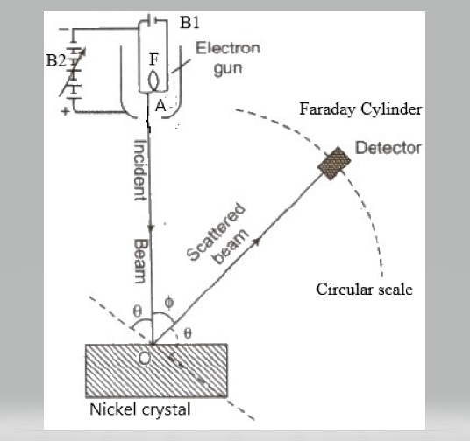
Davisson and Germer Experiment
Apparatus consists of a electron gun with a filament ’ F’ connected to battery B1 which produces collimated beam of electrons.
An anode A connected to a variable voltage source, B2, accelerates the electrons.
These electrons are scattered by the nickle crystal. The crystal can rotate about the axis.
The number of electrons scattered by the crystal in different directions is measured by a detector called Faraday cylinder. The detector can move on a circular scale.

Slide 43
Davisson and Germer Experiment
In the experiment the intensity of the scattered electron beam is determined as a function of the scattering angle, ϕ.
It is found that for the accelerating voltage of 54 volts, the electrons are scattered more pronouncedly at an angle of 50° with the direction of the incident beam.
Maximum indicates that the electrons are diffracted.

Slide 44
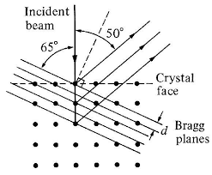
Davisson and Germer Experiment
The rows of atoms at the surface of nickle crystal act like a diffraction grating and the de Broglie waves associated with the electrons undergo diffraction when incident on the crystal.

Slide 45
Davisson and Germer Experiment
The incident beam make a glancing angle(θ) of 65⁰ with the family of Bragg’s planes.
The spacing of planes(d) in Nickel crystal as determined by x-ray diffraction is 0.91 Å
From Bragg’s law 2dsinθ = n λ
λ
λ = 1.65 Å

Slide 46

Davisson and Germer Experiment
The wavelength of electron wave can be obtained from de Broglie equation
V = 54 volts
λ = 1.66 Å
It is seen that the value obtained experimentally using Bragg’s equation and de Broglie equation agreed well.
Hence Davisson and Germer experiment gave conclusive evidence that electrons exhibit diffraction property.

Slide 47
Heisenberg's Uncertainty Principle
Classically, the state of a particle can be defined by specifying its position and momentum at any given time “t”.
At each instant, the position and momentum can be measured accurately.
When a atomic particle is considered as a de Broglie wave packet, then such a accuracy is not possible.

Slide 48
Heisenberg's Uncertainty Principle
A moving particle is equivalent to a wave group and having a group velocity.
If the group is considered to be narrow, it is easier to locate its position, but the uncertainty in calculating its velocity and momentum increases.
If the group is wide, its momentum is estimated easily, but there is great uncertainty about the exact location of the particle.

Slide 49

Heisenberg's Uncertainty Principle
Heisenberg a German scientist in 1927 gave the uncertainty principle which states that “The determination of exact position and momentum of a moving particle simultaneously is impossible’’.
If △x is the uncertainty in measurement of position of particle along x-axis, and △p is the uncertainty in measurement of momentum, then
Or
Statement: Heisenberg uncertainty principle states that both the position and momentum cannot be measured simultaneously with perfect accuracy.

Slide 50

Schrodinger 1 dimensional time independent wave equation
Schrodinger describes the wave nature of a particle in mathematical form and is known as Schrodinger’s wave equation.
Consider a plane wave moving along +ve x- direction with velocity ‘v’. The equation of the wave is written as
Where, a= amplitude of wave
y = displacement of wave in y- direction
x = displacement along x- axis at any instant of time ‘t’.

Slide 51



Schrodinger 1 dimensional time independent wave equation
Taking first and second order derivative w.r.to ‘x’ on both sides
Using y in the above equation, where

Slide 52



Schrodinger 1 dimensional time independent wave equation
In complex wave, the displacement ‘y’ is replaced by ‘ψ’ and wavelength’ λ’ is replaced by de-Broglie’s wavelength
For a moving particle, the total energy is
Where E= total energy,
V= potential energy, U = kinetic energy

Slide 53


Schrodinger 1 dimensional time independent wave equation
U =
Multiply both sides with m
Subs. The value of
in the above equation.
But
This is 1 D equation.

Slide 54
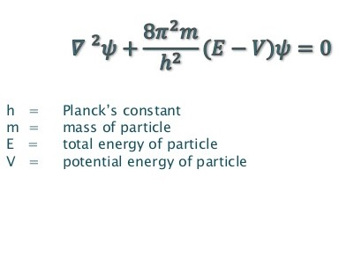
Schrodinger 3 dimensional time independent wave equation

Slide 55

Physical significance of the wave function:
Born’s interpretation
The wave function has no direct physical significance as it is not an observable quantity. It is a complex quantity which connects the particle nature and its associated wave nature statistically.
= is the probability density function.
can be considered as probability amplitude since it is used to find the location of the particle.

Slide 56
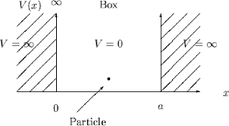
Particle in 1 dimension infinite potential box
If one –dimensional motion of a particle is assumed to take place with zero potential energy over a fixed distance, and if the potential energy is assumed to become infinite at the extremities of the distance, it is described as a particle in a 1-D box, and this is the simplest example of all motions in a bound state.

Slide 57
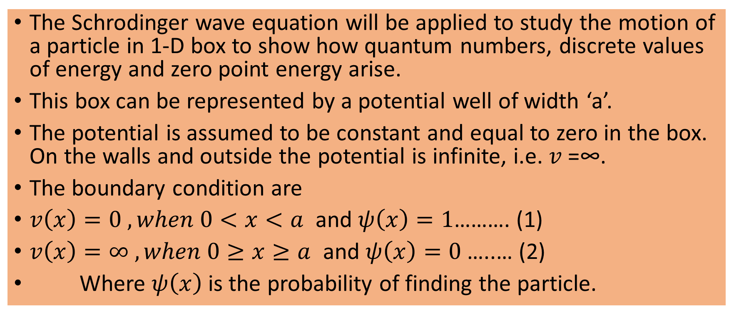
Particle in 1 dimension box

Slide 58
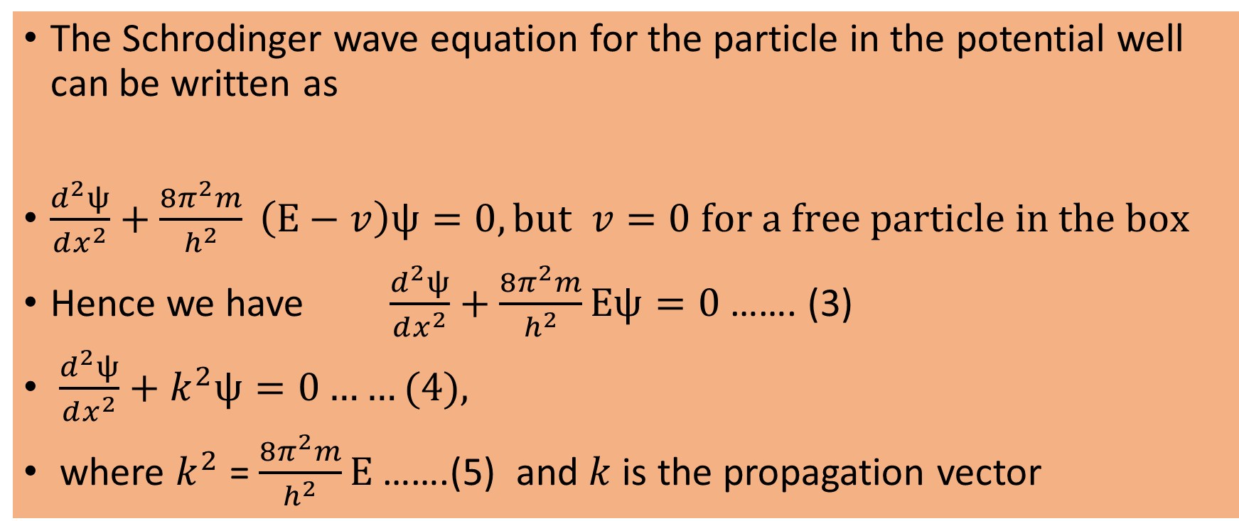
Particle in 1 dimension box

Slide 59
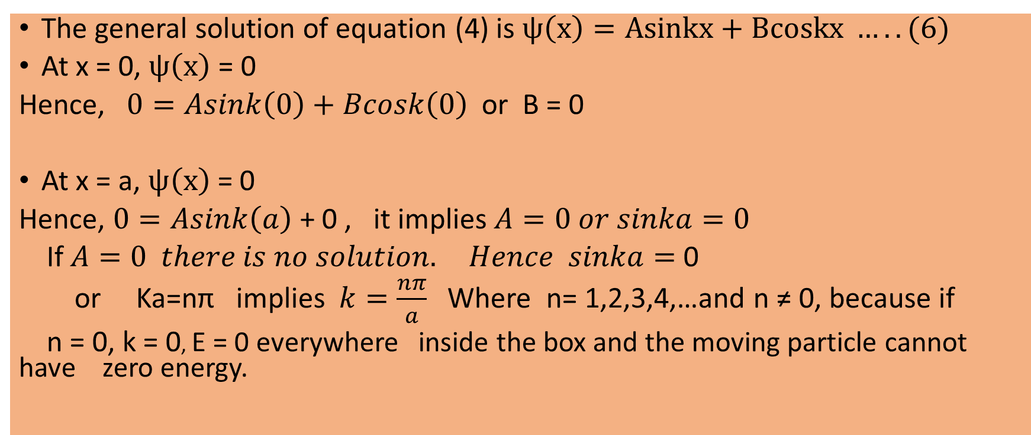
Particle in 1 dimension box

Slide 60
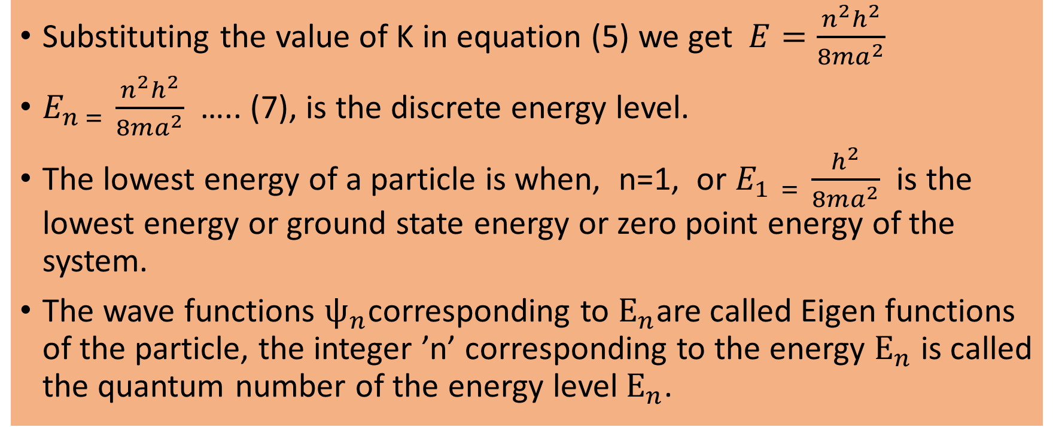
Particle in 1 dimension box

Slide 61
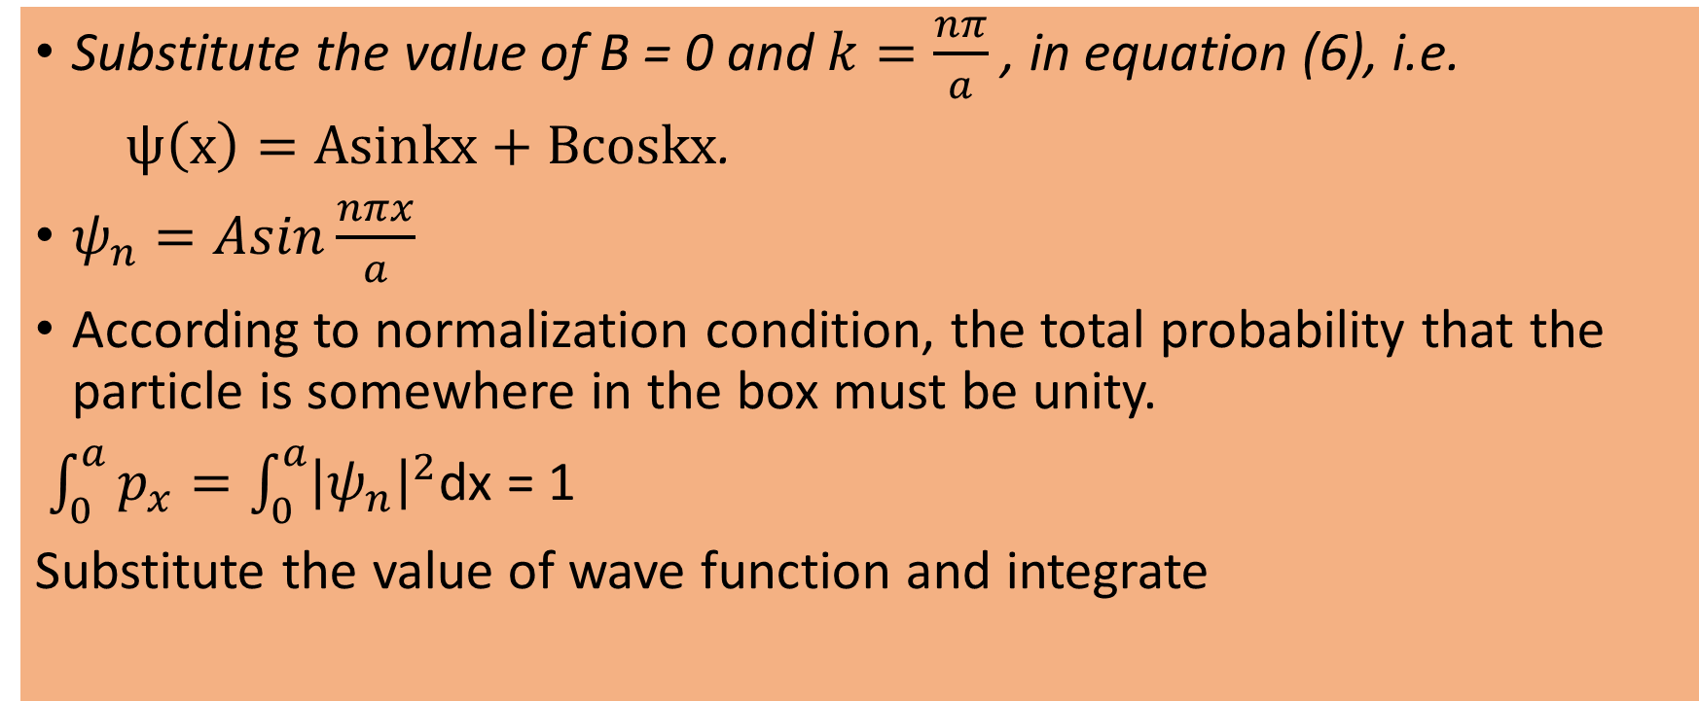
Particle in 1 dimension box

Slide 62
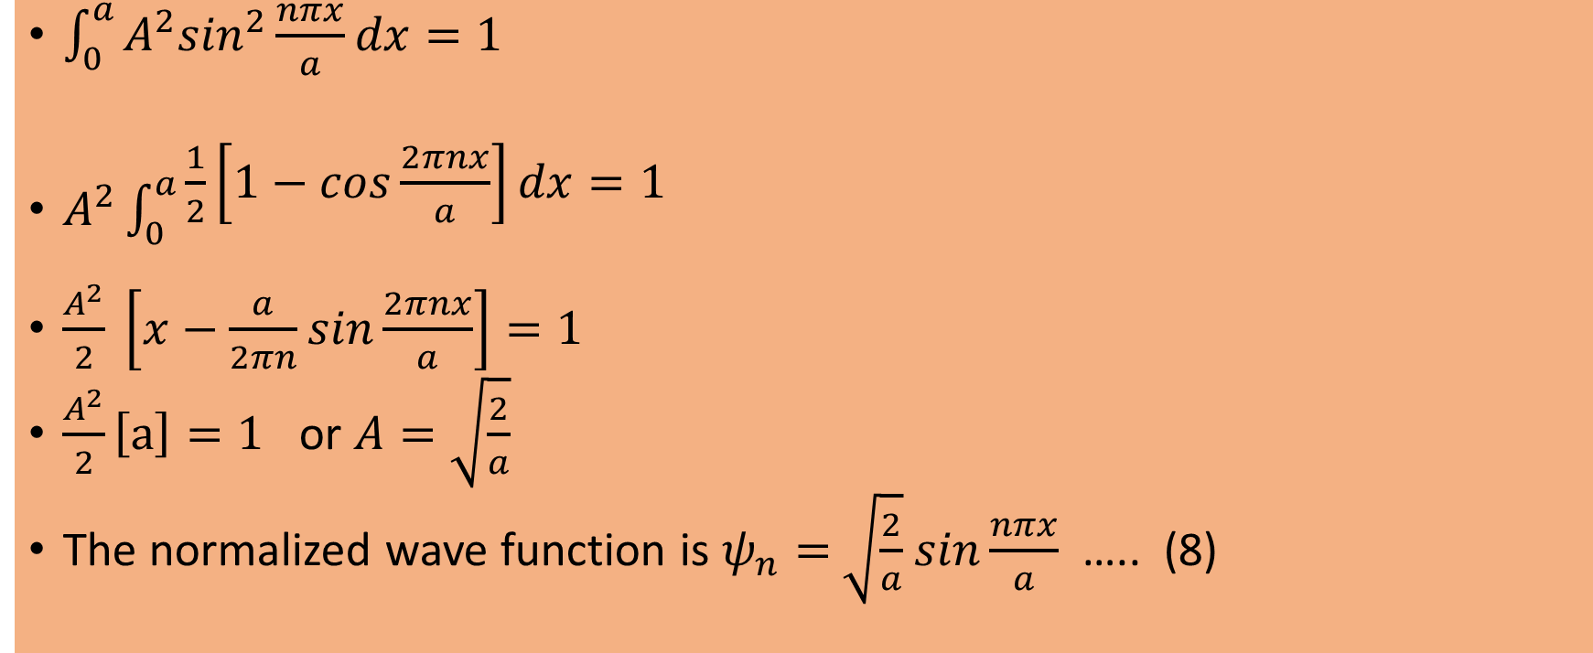
Particle in Three dimensional box

Slide 63
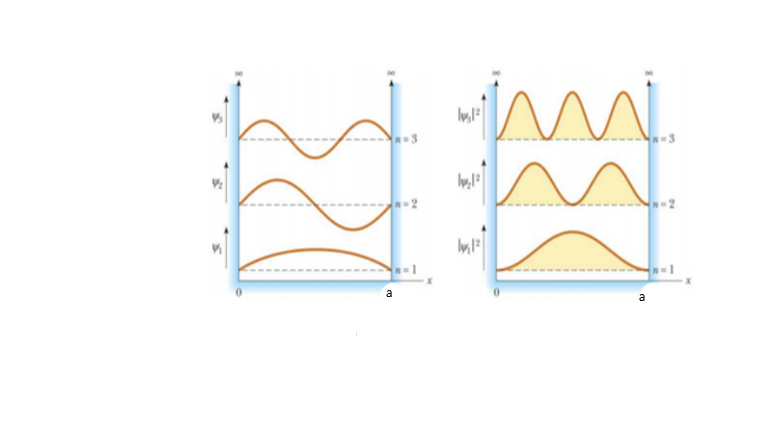
Particle in 1 dimension box

Slide 64
Numerical’s
Calculate the wavelength associated with an electron raised to a potential of 1600 volt.

Slide 65
Numerical’s
Calculate the wavelength associated with an electron raised to a potential of 1600 volt.
Solution: Given Potential(V) = 1600 volt
Formula: For an electron
Substitute the value of V.
Wavelength = 0.31 Å

Slide 66
Numerical’s
2. Calculate the de Broglie wavelength of a proton whose kinetic energy
is 1 * 10⁶ eV. Given mass of proton is 1.67 * 10⁻²⁷ kg.

Slide 67
Numerical’s
2. Calculate the de Broglie wavelength of a proton whose kinetic energy
is 1 * 10⁶ eV. Given mass of proton is 1.67 * 10⁻²⁷ kg.
Solution: Given K.E. = E = 1 * 10⁶ eV = 1 * 10⁶ * 1.6 * 10⁻¹⁹ J
Planck's constant = h = 6.626 * 10⁻³⁴ Js
Mass of proton = m = 1.67 * 10⁻²⁷ kg.
Formula λ =
^{Substituting}
λ = 2.86 * 10⁻¹⁴ m.

Slide 68
Numerical’s
3. Calculate the velocity and kinetic energy of an electron of
wavelength 1.66 * 10⁻¹⁰ m.

Slide 69
Numerical’s
3. Calculate the velocity and kinetic energy of an electron of
wavelength 1.66 * 10⁻¹⁰ m.
Solution: Given wavelength of electron, λ = 1.66 * 10⁻¹⁰ m
Planck's constant, h = 6.626 * 10⁻³⁴ Js
Mass of electron, m = 9.1 * 10⁻³¹ kg.
Formula, on substituting, velocity, v = 0.4386*10⁷ ms⁻¹
K.E. = on substituting, K.E. = 54.5 eV.

Slide 70
Numerical’s
Calculate the minimum energy that an electron can possess in an infinitively deep one dimensional potential well of width 4 nm.

Slide 71
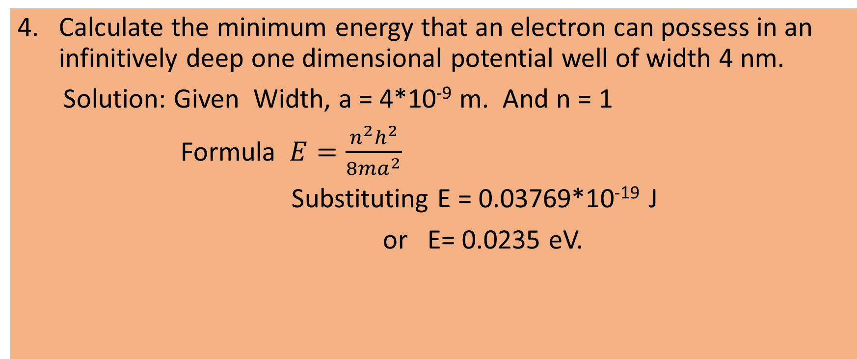
Numerical’s

Slide 72
Numerical’s
5. The wavelength of yellow light is 5890 Å. What is the energy of the photon in the beam.

Slide 73
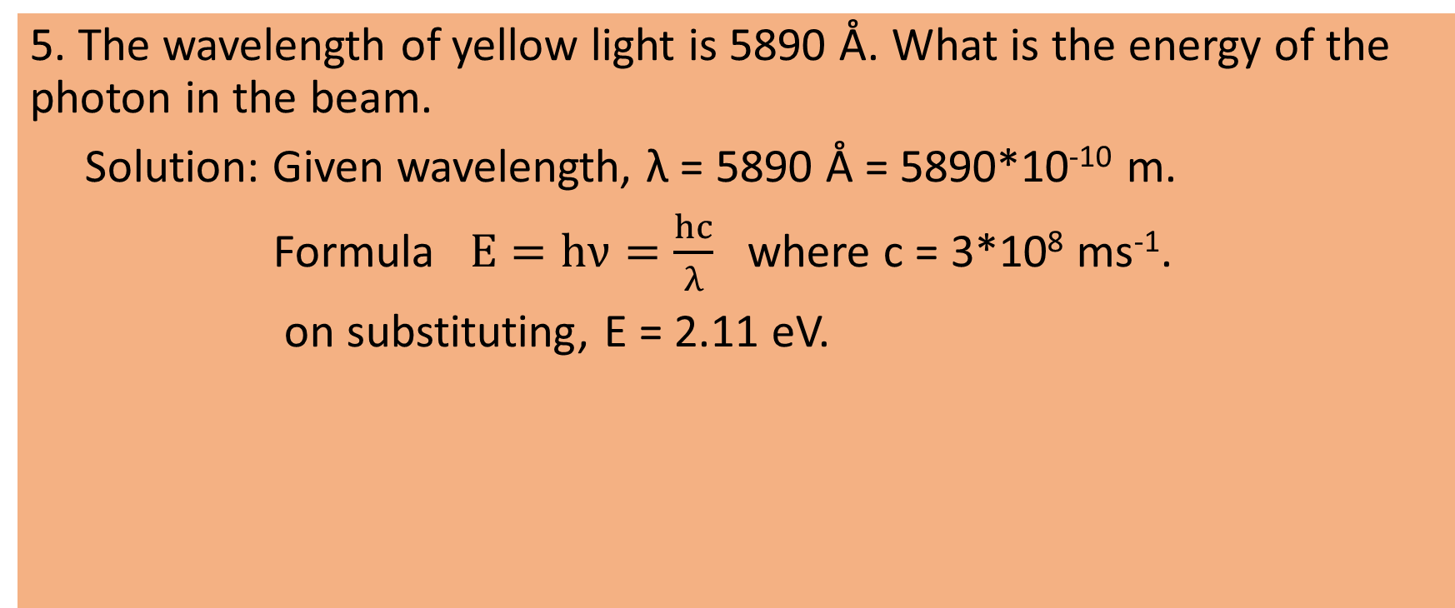
Numerical’s

